Slide 1

RISK AND RESILIENCE BOOTCAMP
10

Slide 2


Slide 3
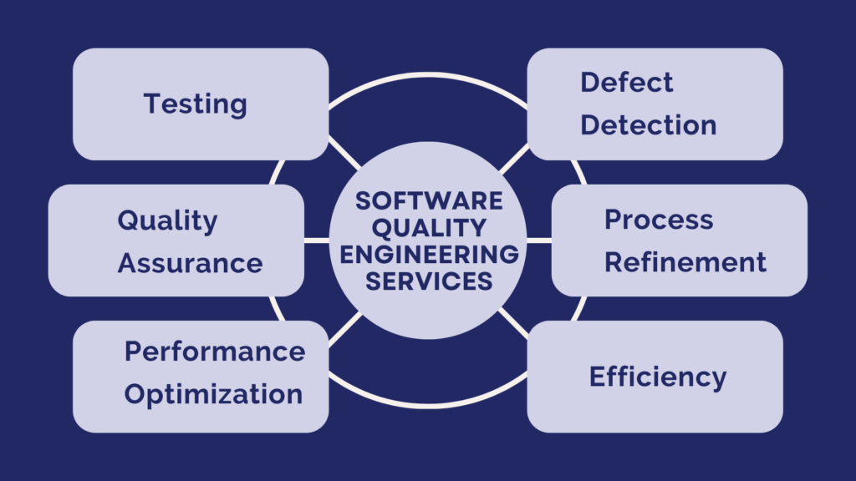
Quality engineering and risk testing
This section is an introduction to
Software Quality Engineering (SQE)
Risk Testing
This will not be a deep dive into the general topics of quality or testing
We will just focus on aspects of these topics that are important in understanding QE and risk testing

Slide 4
definitions
Defining quality
Defining exactly what quality is has been a topic of debate for centuries
The definition used today expresses quality in terms of quality attributes
Every product has features
Quality is assigned to a feature by stakeholders based on their requirements
Quality is a subjective decision
For example, a cell phone plan has unlimited calling to Europe
Whether or not this improves the quality of the plan depends on whether or not a stakeholder knows and talks to people in Europe
The quality is not a property of the product but rather how well it meets the quality requirements of the stakeholders

Slide 5
definitions
The following concepts are often confused
There is an overlap in their areas of responsibility
But each has a specific focus and objective
Quality control
Quality assurance
Quality engineering
Reliability engineering

Slide 6
definitions
Quality control (QC)
QC is a product-oriented activity that involves testing, inspection, and validation to verify that deliverables meet quality specifications
Scope
Focused on identifying and correcting defects in outputs
These include: code, configurations, components, or operational deliverables
Reactive in nature: detects problems after creation but before release or operation
Filters out defective products as a last stage in production
Common techniques
Functional testing, integration testing, performance benchmarking
Inspection and validation of production releases
Regression and acceptance testing
Analogy
QC is like inspecting a finished bridge for cracks or misaligned bolts before cars drive across

Slide 7
definitions
Quality assurance (QA)
QA is a process-oriented discipline ensuring that methods, procedures, and standards are followed correctly so that the resulting product or service is likely to meet requirements
Scope
QA focuses on process conformance
Verifying that defined policies, design reviews, and documentation steps are executed
Typical outputs: checklists, audit results, process capability assessments.
Risk and resilience
QA ensures governance controls exist and are followed
Reduces operational risk by ensuring process discipline before incidents occur
Analogy
QA is like ensuring the bridge was designed and built according to engineering codes and safety regulations

Slide 8
definitions
Quality engineering (QE)
QE discipline of integrating quality practices, automation, and data-driven validation across the entire system lifecycle to prevent defects and ensure reliability and resilience
One of the key characteristics is that QE deals with computational models of system performance and behavior
Scope
Encompasses quality assurance, control, and reliability
Embeds continuous feedback loops, risk awareness, and automation
For example: CI/CD pipelines, observability
Combines software, systems, and operational perspectives
Especially relevant in DevOps, SRE, and regulated financial IT environments
Key practices
Defines quality models according to industry standards
Automates quality gates for attributes like security, performance, code analysis
Implements risk-based testing focusing on high-impact scenarios
Integrates observability metrics like availability, latency, MTTR, SLA adherence

Slide 9
definitions
Quality engineering (QE)
Risk and resilience
QE aligns directly with preventive risk management
Ensures processes and systems are built to withstand failure
Improves operational resilience through predictable performance, early defect detection, and continuous monitoring
Non-functional requirements
Primarily used to engineer the non-functional performance properties of a system
These properties tend to be common across all systems, irrespective of their functionality
Stress, load, throughput, response time, transaction latency, mean time to failure, etc.
Because of the common context for operational characteristics
There are standard models, processes, statistical and mathematical models used in QE
Forces these properties to be rigorously quantified during development
Analogy
QE is like building a bridge with sensors, predictive maintenance, and self-healing materials
Quality by design

Slide 10
definitions
Reliability engineering (RE)
A common distinction between QE and RE is
QE defines and quantifies performance characteristics that meet the requirements
RE focuses on analyzing, predicting, and improving system performance over time
Goal is to minimize failures and ensure consistent availability under operational stress
Scope
Studies how and why systems fail
Uses statistical models, fault analysis, and redundancy design
Concerned with probability of failure-free operation over a specified time
Risk and resilience
Enhances resilience engineering, focusing on maintaining function despite component failures
Transforms resilience from reactive recovery to predictive, measurable dependability

Slide 11
definitions
Reliability engineering (RE)
Key techniques
FMEA (Failure Modes and Effects Analysis)
Fault Tree Analysis (FTA)
Reliability Growth Modeling
Stress and Endurance Testing
Resilience Engineering (study of adaptive capacity in complex systems)
Standards
IEEE 1413 (Reliability Predictions)
MIL-STD-1629A (FMEA)
ISO 9001 and ISO 25010 reliability criteria
NIST SP 800-160 Vol.2 (Systems Security and Resilient Engineering)
Analogy
Calculating how long the bridge will last under different loads and ensuring it can withstand storms, traffic surges, or material fatigue

Slide 12
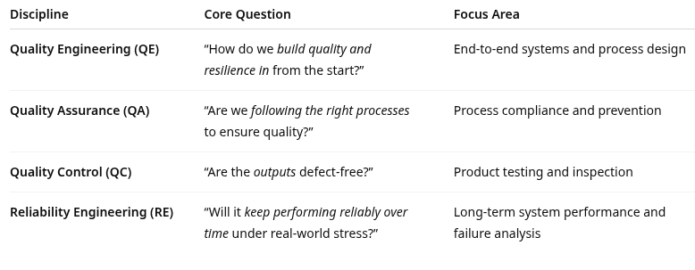
comparison

Slide 13
Quality Engineering
Quality vs. Reliability
Quality
Conformance to requirements, customer expectations, and specifications
Reliability
The probability that a system will perform its intended function without failure over a specified period
Quality engineering works with
Quality planning
Defining quality goals, metrics, and acceptance criteria
Quality assurance
Establishing processes and standards to prevent defects
Quality control
Monitoring outputs and detecting defects
Continuous improvement
Using analytics and feedback to refine processes

Slide 14
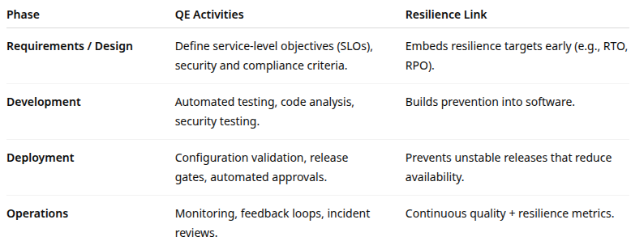
Lifecycle integration

Slide 15
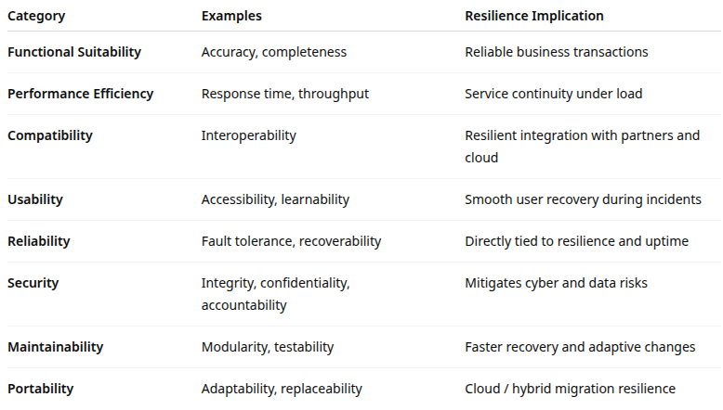
ISO/IEC 25010: Software Quality items

Slide 16
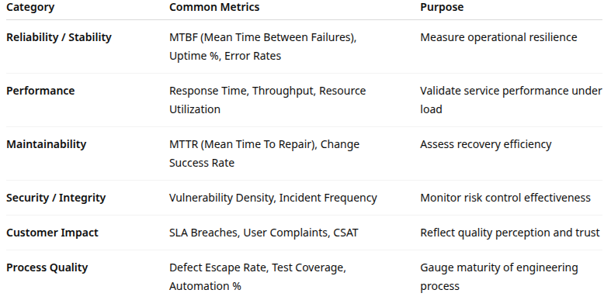
Quality Metrics

Slide 17
Risk testing
Risk testing process
Identify risks
From risk register, past incidents, threat modeling, and BIAs
Prioritize scenarios
Based on impact and likelihood
Design test cases
Simulate control failure or degradation
What happens if a patch fails? backup corrupts?
Execute tests
Controlled or sandboxed environments, or live “chaos” experiments
Document results
Capture effectiveness of controls and response time
Improve controls
Feed lessons into SOPs and process maturity models

Slide 18
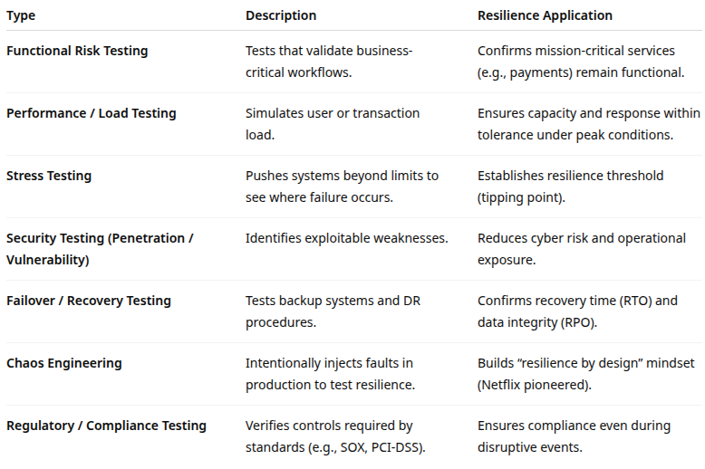
Types of risk testing

Slide 19
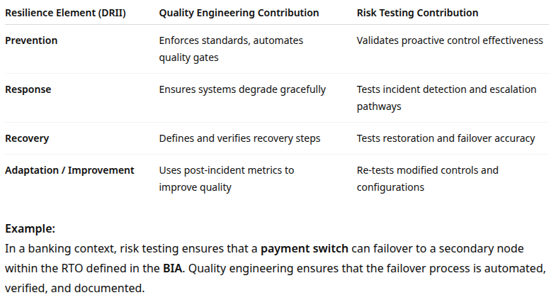
QE, risk testing and resilience

Slide 20
Best practices
Best practices and governance alignment
Shift quality and risk testing left
Integrate QE and risk testing early in DevOps pipelines
Automate quality gates
For example: performance, security scans before deployment
Adopt continuous testing
Align with CICD workflows using automated regression and resilience tests
Use risk-based test prioritization
Focus test effort on high-risk, high-impact components
For example: critical services, security controls, compliance functions
Measure and report
Tie test outcomes to enterprise risk metrics (e.g., number of high-risk defects closed before release)
Map QE and risk testing activities to COBIT processes

Slide 21
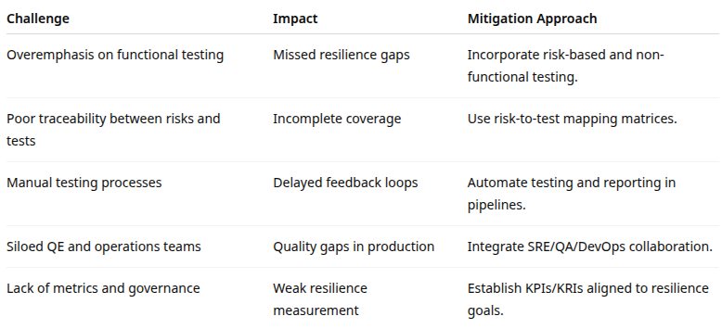
Common Challenges

Slide 22
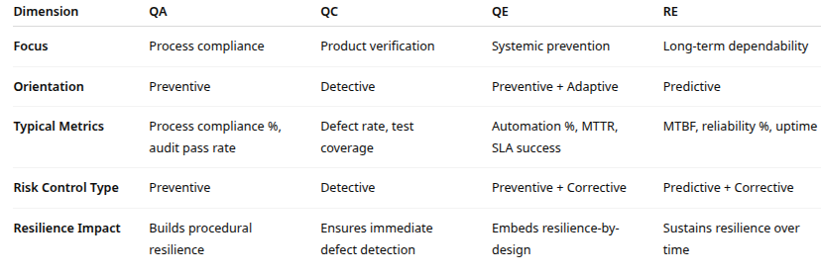
recap

Slide 23

Q&A and open discussion
Notes:
Now is the time to engage in an interactive Q&A session where you can ask questions, share insights, and clarify any doubts about the topics we have covered so far.
This open discussion is designed to ensure that every participant has the opportunity to voice their thoughts and learn from the collective experience of the group.
Your questions and comments are valuable as they help us identify areas that may need further explanation and enable us to tailor future sessions to your needs.
We encourage you to speak up and contribute to the dialogue, as this interaction is one of the key components of our interactive learning approach.
As the session progresses, take note of any questions or ideas that you would like to revisit, and feel free to share your perspectives with the class.

